Slide 1

COEN 166 Lab Assignment 6 Instruction

Slide 2
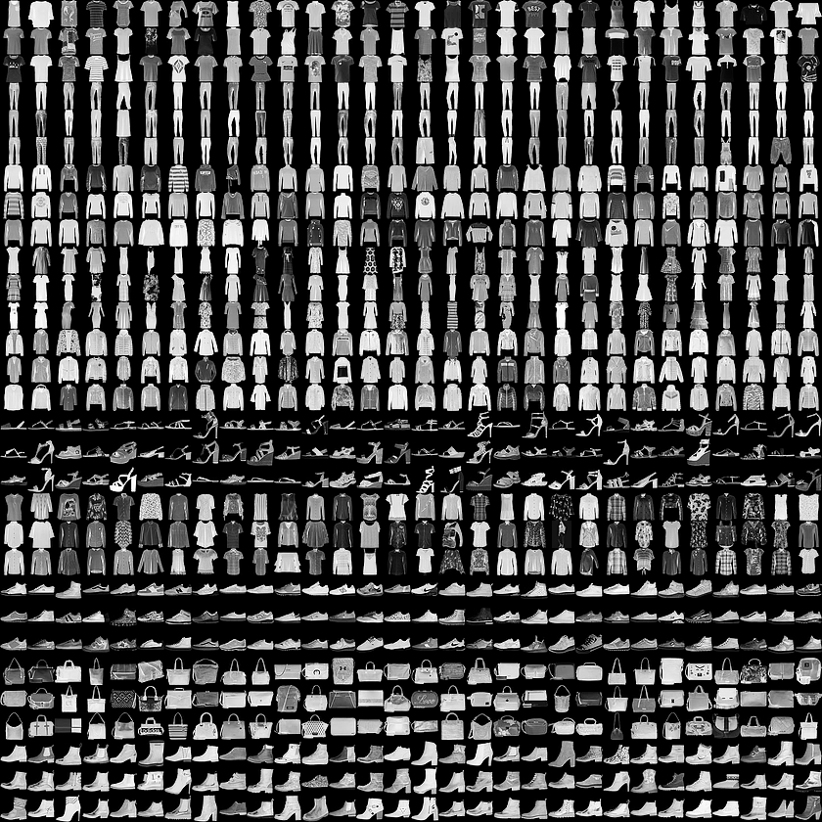
Fashion MNIST

Slide 3
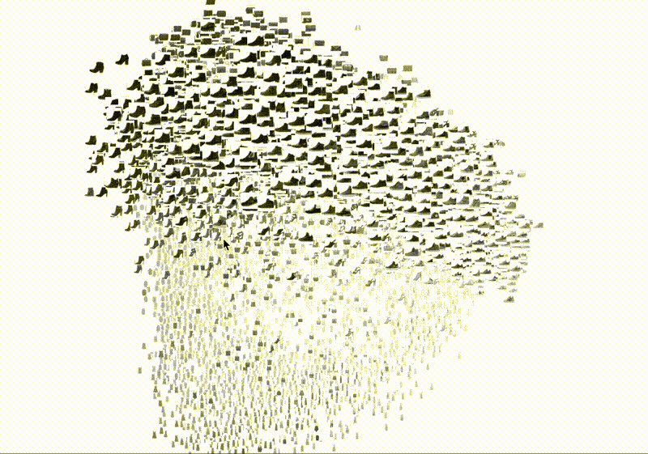
Fashion MNIST

Slide 4
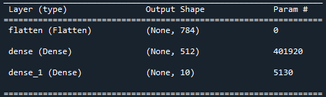
Neural Network

Slide 5
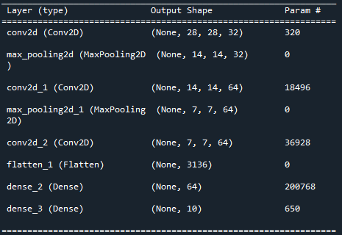
Convolutional Neural Network

Slide 6
Report
1. Select one image from each class of the dataset to display as a gray-scale image.
2. For Problem 1, give the recognition accuracy rate of the test set, and show the confusion
matrix.
3. For Problem 2, give the recognition accuracy rate of the test set, and show the confusion
matrix.
4. Group member contributions in percentage.

